Slide 1
20XC15 -Problem Solving and C Programming
Multidimensional Arrays in C

Slide 2
Outline
Introduction – Multidimensional Arrays
Declaration
Memory allocation
Initializing
Processing

Slide 3
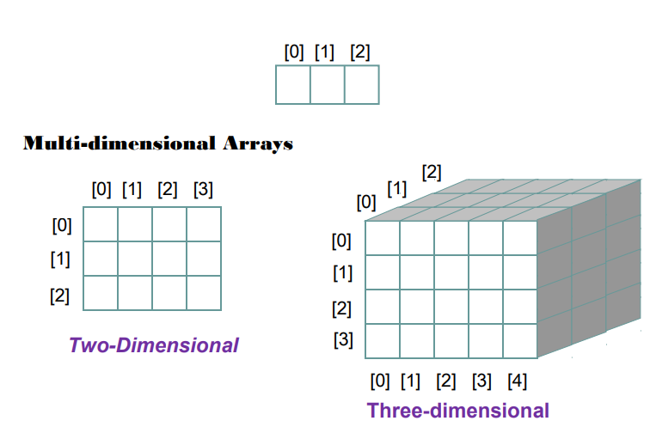
Arrays
One dimensional arrays are linear containers

Slide 4
Introduction
An array is used to store multiple values of same type
For example, sales of a product in 12 months can be stored in a common memory allocation using an array.
Some times we need to store a table of data in a single variable.
For example
  Suppose we need a table of 10 rows and 12 columns to store the sales of 10 products in 12 months
  We can define 10 1-D arrays each of size 12 to store the sales of 10 products in 12 months
  Rather defining 10 arrays of 12 elements each, we can define a two dimensional array of 10 rows and 12 columns to store tabular data of 10 rows and 12 columns

Slide 5
Introduction
Arrays in C can have multiple indices
A common use of multidimensional arrays, which the C standard refers to as multidimensional arrays (an array with two or more dimensions)
  To represent tables of values consisting of information arranged in rows and columns
To identify a particular table element, we must specify two indices:
  The first (by convention) identifies the element’s row and
  The second (by convention) identifies the element’s column
Tables or arrays that require two indices to identify a particular element are called two-dimensional arrays
Multidimensional arrays can have more than two indices

Slide 6
Two Dimensional(2D) Arrays
2D Array Declaration
element-type array_name [ Rowsize ] [ Columnsize];
Examples
  int marks[4][5];
  float sales[12][25];
  double matrix[100][100];
  char name[40][20];

Slide 7
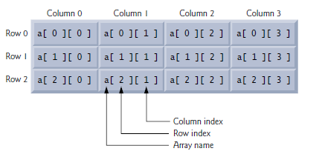
Two Dimensional(2D) Arrays
Two pairs of brackets are used to declare a two dimensional array
The number of rows is specified in the first pair of brackets and number of columns is specified in the second pair of brackets
int a[3][4];
The above statement allocates the memory allocation of 3 rows and 5 columns with the name a

Slide 8
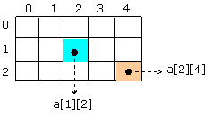
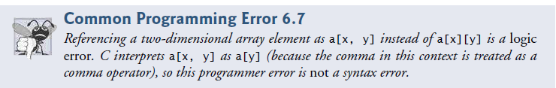
Two Dimensional(2D) Arrays
Every element in a two dimensional array is accessed with its row index and the column index
Where index of rows and columns start from 0
If we take a two dimensional array of n rows and m columns then the index of last row is n-1 and the index of last column is m-1
int a[3][5];

Slide 9
How is a 2-D array stored in memory?
A 2D array is stored in the computer's memory one row following another - C is a row major language
The address of the first byte of memory is considered as the memory location of the entire 2D array
When a two dimensional array of n rows and m columns is declared then n single dimensional arrays of m elements each is allocated in adjacent memory allocations
For example
If we declare a two dimensional array like
int a[3][5];
then 3 single dimensional arrays of 5 integer elements each is
allocated in the memory

Slide 10
How is a 2-D array stored in memory?
Starting from a given memory location, the elements are stored row-wise in consecutive memory locations
  x: starting address of the array in memory
  c: number of columns
  k: number of bytes allocated per array element
  a[i][j] → is allocated memory location at address
  x + (i * c + j) * k

Slide 11
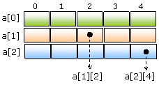
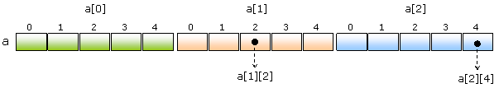
Memory allocation of a 2D array
For example
int a[3][5];
  a[i][j] → is allocated memory location at address x + (i * c + j) * k
    Assume that X =1000, each integer occupies 4 bytes of memory
    Compute the memory address of a[1][2] , here i=1, j=2, C=5
    Address of a[1][2] = 1000+ (1 * 5 + 2) * 4
    = 1000 + 7 * 4 = 1000+28
    = 1028

Slide 12
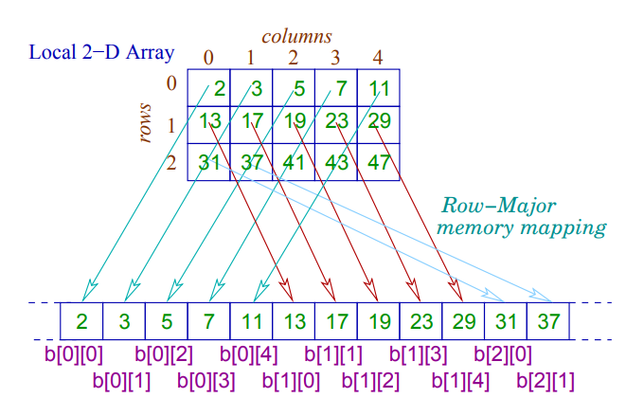
Memory allocation of a 2D array

Slide 13
How is a 2-D array stored in memory?
A two dimensional array is a set of one dimensional arrays of same size and type allocated in adjacent memory allocations

Slide 14
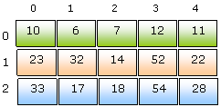
Initializing a 2D Array
Assigning a set of sets of elements of same type while declaration of a two dimensional array is called initializing while declaration.
int a[3][5]={{10,6,7,12,11},{23,32,14,52,22},{33,17,18,54,28}};
While initializing a matrix, it is optional to specify the size of rows but it is mandatory to specify the number of columns.
int a[ ][5]={{10,6,7,12,11},{23,32,14,52,22},{33,17,18,54,28}};
It is also optional to specify the subset braces
int a[ ][5]={10,6,7,12,11,23,32,14,52,22,33,17,18,54,28};

Slide 15
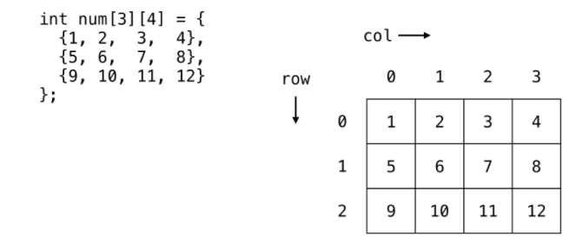
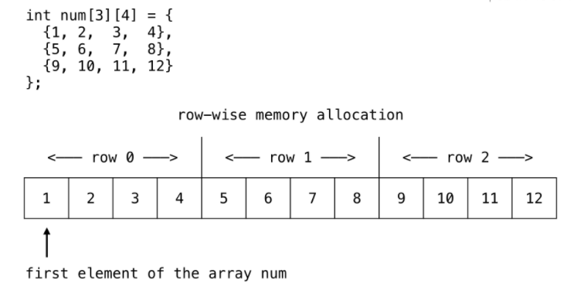
Initializing a 2D Array
Use braces to separate rows in 2-D arrays

Slide 16


Initializing a 2D Array
When initializing arrays, the outermost pair of braces cannot be omitted
If the initializer list includes all the initializers for the object being initialized, the inner braces can be omitted
For example

Slide 17
Initializing a 2D Array
int X[4][3] = { 1, 2, 3, 4 , 5, 6};
  X[0][0] = 1
  X[0][1] = 2
  X[0][2] = 3
  X[1][0] = 4
  X[1][1] = 5
  X[1][2] = 6
  X[2][0] = 0
  X[2][1] = 0
  X[2][2] = 0
  X[3][0] = 0
  X[3][1] = 0
  X[3][2] = 0
int X[4][3] = { {1, 2}, {3, 4}, {5, 6} };
X[0][0] = 1
X[0][1] = 2
X[0][2] = 0
X[1][0] = 3
X[1][1] = 4
X[1][2] = 0
X[2][0] = 5
X[2][1] = 6
X[2][2] = 0
X[3][0] = 0
X[3][1] = 0
X[3][2] = 0

Slide 18
Initializing a 2D Array
If the values are missing in the initializer list, they are automatically set to zero
Example
int arr[2][3]={ {1,1},
{2}
};
To initialize all the elements of a 2D array to 0
int arr[2][3] ={0};
int arr[2][3] = { {0}, {0} };
arr[0] [0] = 1
arr[0] [1] = 1
arr[0] [2] = 0
arr[1] [0] = 2
arr[1] [1] = 0
arr[1] [2] = 0

Slide 19
Assignment
int arr[3][4];
  arr[0] [0] = 10
  arr[0] [1] = 21
  arr[0] [2] = 32
  arr[0] [3] = 43
  arr[1] [0] = 21
  arr[1] [1] = 34
  arr[1] [2] = 45
  arr[1] [3] = 56
  arr[2] [0] = 37
  arr[2] [1] = 48
  arr[2] [2] = 59
  arr[2] [3] = 62

Slide 20
Loops to Traverse
To access an element from the matrix, we need to specify the row index as the 1st subscript and the column index as the 2nd subscript
For example : a[1][2] access the element at 1’s row and 2’s column
To traverse along the 0th row, the row subscript must be 0 and the column subscript must change for j=0, 1, 2, 3 and 4
for(j=0;j<5;j++) /* here 5 is number of columns */ printf("%d",a[0][j]);
To traverse along the 1st row, the row subscript must be 1 and the column subscript must change for j=0, 1, 2, 3 and 4
for(j=0;j<5;j++) /* here 5 is number of columns */ printf("%d",a[1][j]);

Slide 21
Loops to Traverse
for(j=0;j<5;j++) /* here 5 is number of columns */ printf("%d",a[0][j]);
j=0 a[0][0] – printf prints the element stored in this location
j=1 a[0][1]
j=2 a[0][2]
j=3 a[0][3]
j=4 a[0][4]

Slide 22
Loops to Traverse
To traverse along the 2nd row, the row subscript must be 2 and the column subscript must vary for j=0, 1, 2, 3 and 4
for(j=0;j<5;j++) /* here 5 is number of columns */ printf("%d",a[2][j]);
By observing all the three loops, we understand that the same loop is being repeated except the changing in row index.
To traverse 0th row it is a[0][j]
To traverse 1st row it is a[1][j] and
To traverse 2nd row it is a[2][j]

Slide 23
Loops to Traverse
Here an outer loop can be used to select a row using for i=0, 1 and 2
Example
for(i=0;i<3;i++) /* here 3 is number of rows */
{
for(j=0;j<5;j++) /* here 5 is number of columns */
{
printf("%d",a[i][j]);
}
}

Slide 24
How to read and print the elements of a 2-D array?
By reading them one element at a time
for (i=0; i<nrow; i++)
for (j=0; j<ncol; j++)
scanf (“%f”, &a[i][j]);
The ampersand (&) is necessary
The elements can be entered all in one line or in different lines
By printing them one element at a time
for (i=0; i<nrow; i++)
for (j=0; j<ncol; j++)
printd (“\n%f”, a[i][j]);
The elements are printed one per line

Slide 25
How to read and print the elements of a 2-D array?
The elements are all printed on the same line
for (i=0; i<nrow; i++)
for (j=0; j<ncol; j++)
printd (“%f”, a[i][j]);
To print the elements nicely in matrix form
for (i=0; i<nrow; i++)
{ printf (“\n”);
for (j=0; j<ncol; j++)
printf (“%f ”, a[i][j]);
}

Slide 26
Loops to traverse a matrix
Output:
Elements of matrix are:
10 6 7 12 11
23 32 14 52 22
33 17 18 54 28
Program to print the matrix:
#include<stdio.h>
int main()
{
int a[][5]={{10,6,7,12,11},{23,32,14,52,22},{33,17,18,54,28}};
int i,j;
printf("Elements of matrix are:\n");
for(i=0;i<3;i++) /* selecting rows */
{
for(j=0;j<5;j++) /* traversing through selected row */
{
printf("%d",a[i][j]);
}
printf("\n"); /* Blank line between the rows */
}
return 0;
}

Slide 27
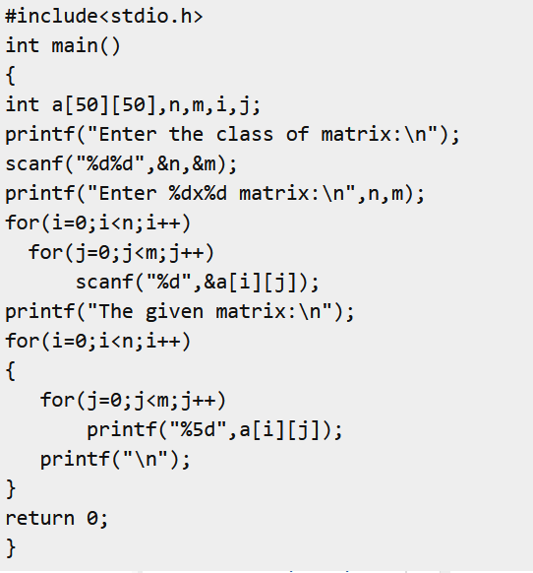
Program to Accept a n x m matrix and print the matrix
Output:
Enter the class of matrix:
3 4
Enter 3×4 matrix:
12 45 67 88
32 56 44 23
78 56 33 89
The given matrix:
12 45 67 88
32 56 44 23
78 56 33 89

Slide 28
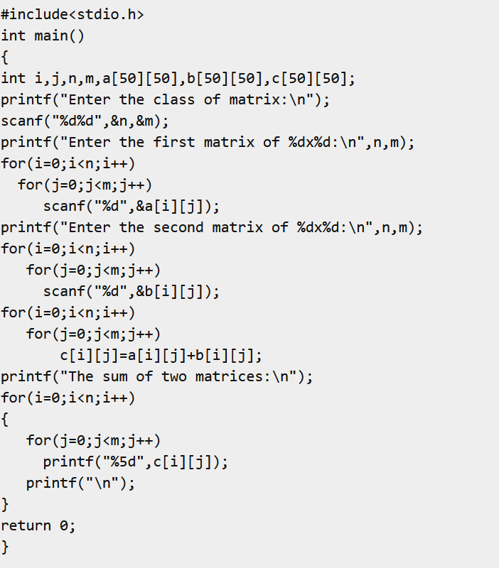
Program to accept two nxm matrices and print the sum of them by storing onto another matrix
Output:
Enter the class of matrix:
3 4
Enter the first matrix of 3×4:
4 5 7 8
2 1 6 1
6 9 2 6
Enter the second matrix of 3×4:
10 34 4 5
12 54 15 7
10 9 3 2
The sum of two matrices:
14 39 11 13
14 55 21 8
16 18 5 8

Slide 29
Multidimensional Arrays
Multidimensional arrays can have three, four or more dimensions
Syntax
element-type aname [size1] [size 2] … [size n];
element-type aname [ ][ size 2] … [size n];
Example
int z[3][2][4]={ {{6,2,5,6},{1,4,9,3}},
{{5,3,9,0},{1,2,6,7}},
{{8,6,1,5},{3,5,2,4}}
};
z is a three dimensional array with three matrices of size 2×4
Every element in a three dimensional array is accessed using three subscripts. The first subscript is the table index, second subscript is the row index and the third subscript is the column index

Slide 30
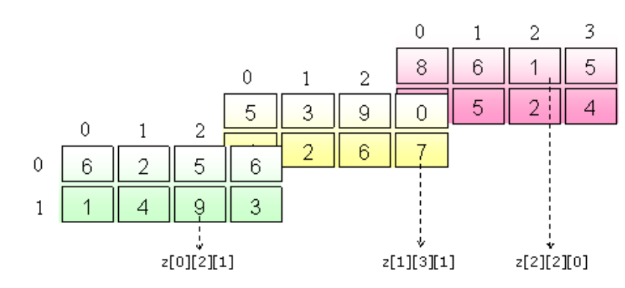
Multidimensional Arrays
int z[3][2][4]={ {{6,2,5,6},{1,4,9,3}},
{{5,3,9,0},{1,2,6,7}},
{{8,6,1,5},{3,5,2,4}}
};

Slide 31
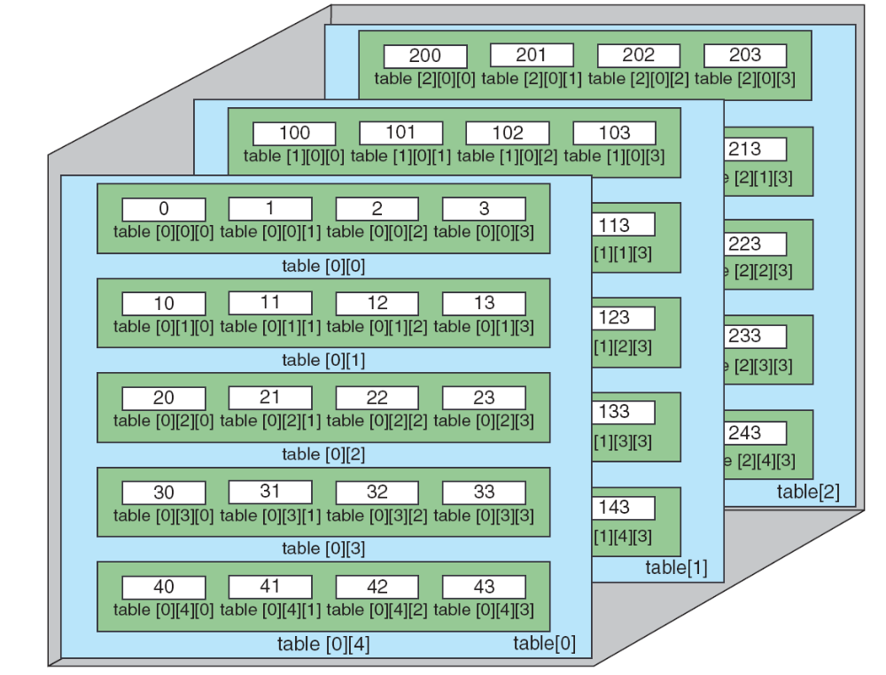
C View of Three-dimensional Array

Slide 32
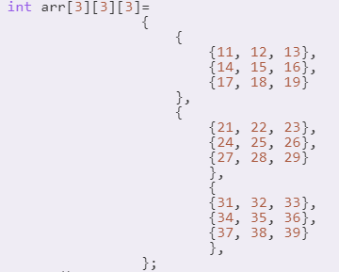
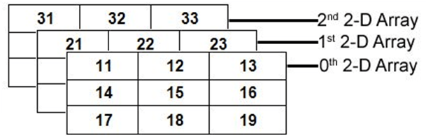

Multidimensional Arrays – Representation in Memory
A 3D array is a collection of 2D arrays, and a 2D array is a collection of 1D arrays

Slide 33
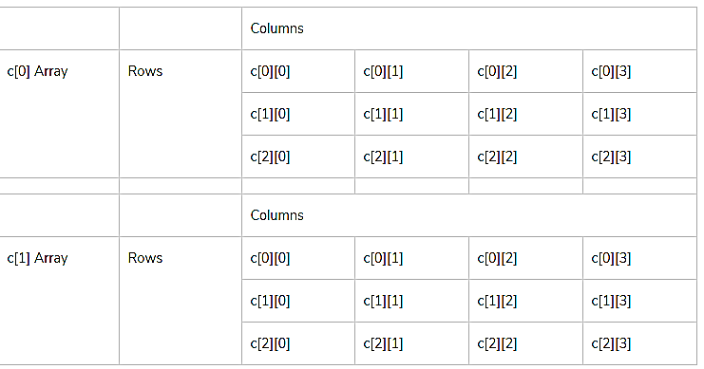
Multidimensional Arrays
Reading a 3D array
for(k=0;k<t;k++) // k=2
{ for(i=0;i<n;i++) //n=3
{ for(j=0;j<m;j++) //m=4
scanf("%d",&c[k][i][j]);
}
}
int c[2][3][4];

Slide 34
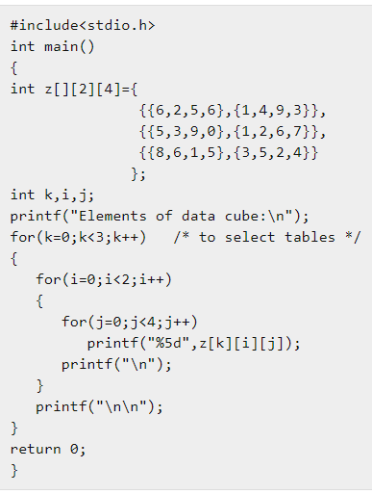
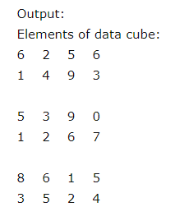
Multidimensional Arrays

